Slide 1

AIRLINE RESERVATION SYSTEM
AOOP PROJECT

Slide 2
TEAM MEMBERS
2110030348-SAI CHARAN
2110030297-YASHWANTH
2110030304-BHANU PRAKASH
2110030308-SHIVA PRASAD

Slide 3
INTRODUCTION
The name of this project is airline reservation system. Airline reservation system project provides option for viewing different flights available with different timings and date for a particular destination and provides customers with the facility to book a ticket, cancel a particular reservation seat but it does not allow the customer to change a particular part of his reservation and he can modify all his details. This project 'airline reservation system' is very useful for small airlines as it covers all the basic needs of airlines reservation company.

Slide 4
DOCUMENT AND REPORT INFORMATION
1. Administrator/User Login Page
2. Change Password Page
3. Forgot Password Page
4. Edit Profile
5. General Settings Page
6. Search Flight Page
7. Book Ticket Page
8. Ticket Payment Page
9. My Ticket Page
10. Cancel Ticket Page
11. Customer Feedback

Slide 5
The main purpose of this project airline reservation system' is to reduce the errors involved in the manual airline reservation system process and make it convenient for the end users and customers to book the flights as when they require. They can utilize this software to make reservations, cancel a particular reservation.
Airline reservation system project provides option for viewing different flights available with different timings and date for a particular destination and provides customers with the facility to book a ticket, cancel a particular reservation seat but it does not allow the customer to change a particular part of his reservation and he can modify all his details.

Slide 6
SOME KEY FEATURES
• Updating the flight schedule and timings and fare.
• View the passenger list.
• View the available seats in the flights.
• Cancel the tickets.
• Create new airline schedule, timings of the Flight and fare.
• Maintain airline schedule, timings of the Flight and fare.

Slide 7
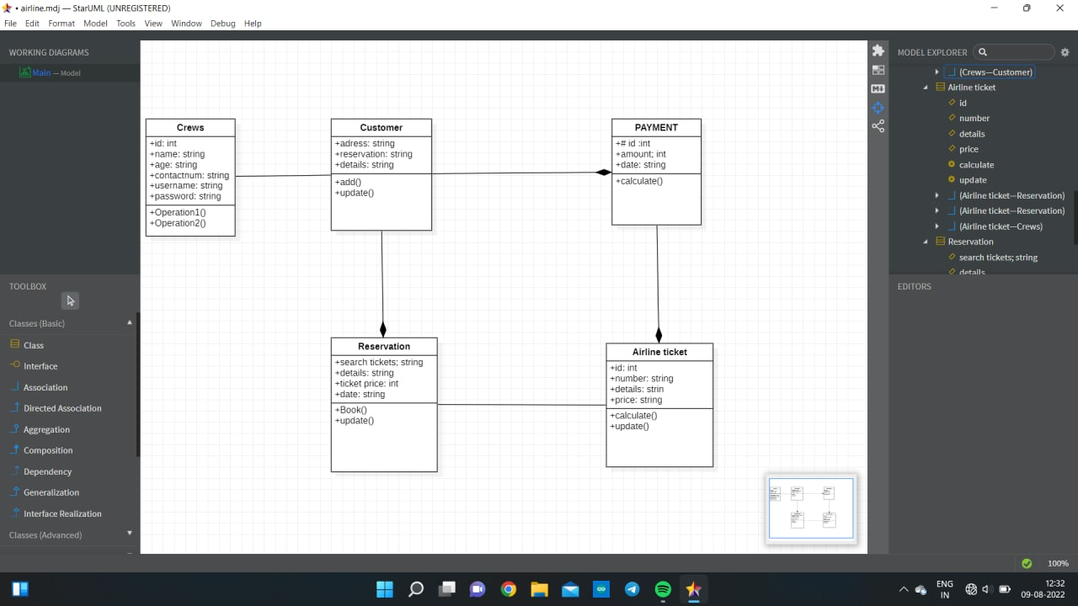
CLASS DIAGRAM

Slide 8
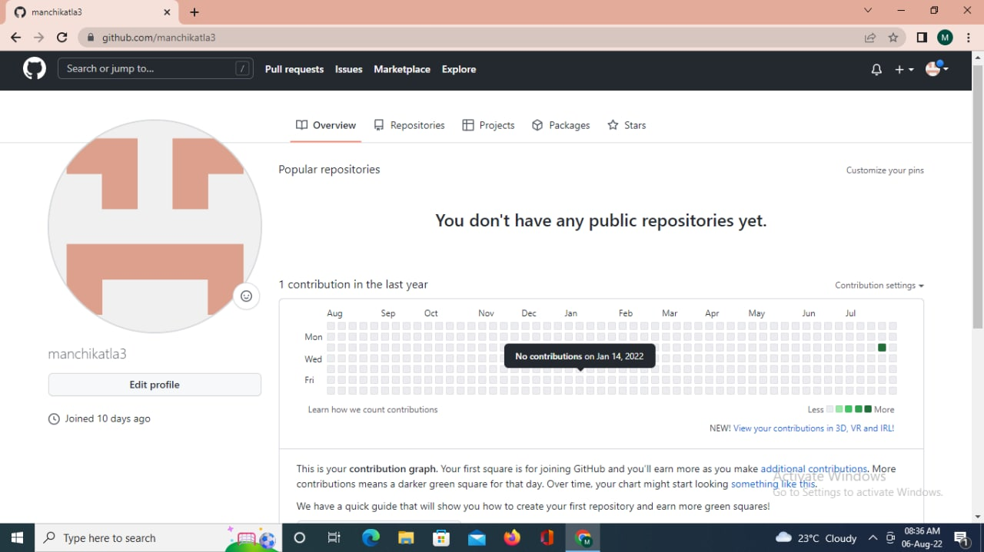
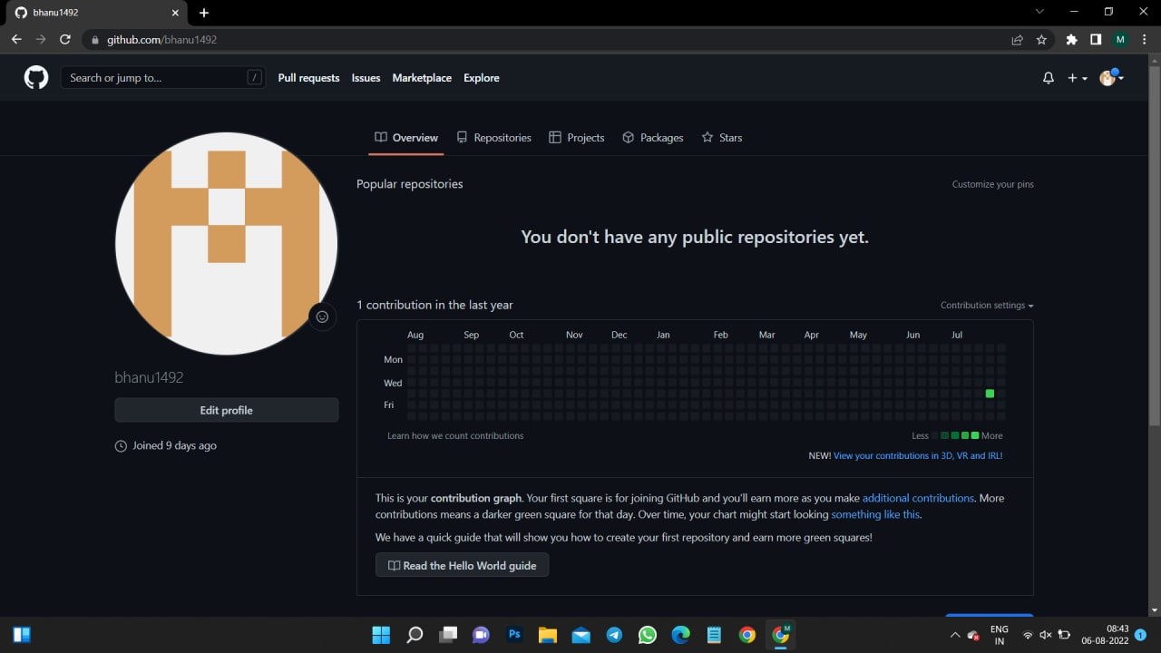
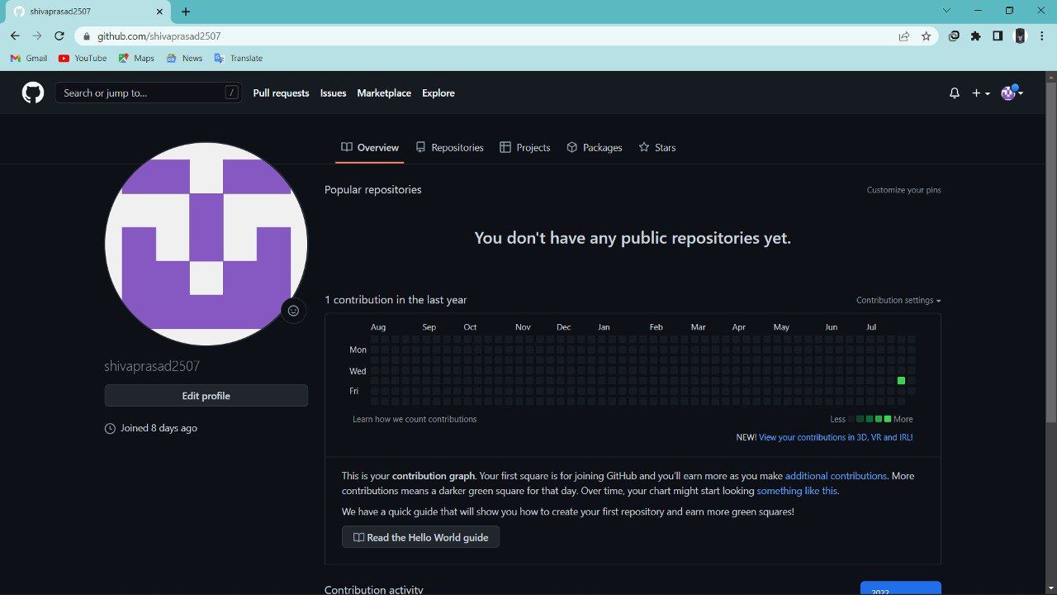
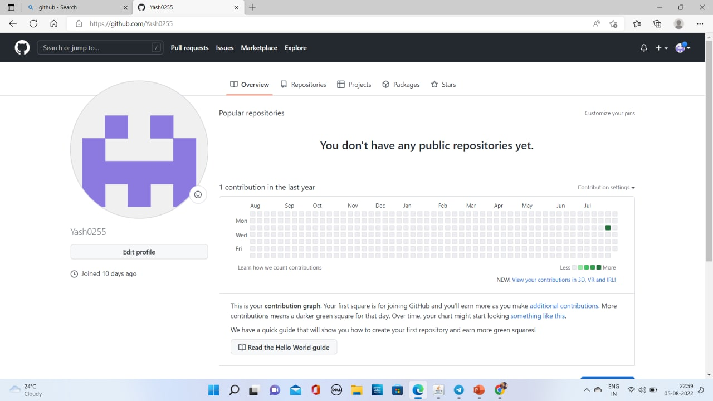
GITHUB SETUP

Slide 9
CONCLUSION
The web based “airline reservation system” project is just another attempt to stimulate the basic concepts of airline reservation system. The system follows a simple process which allows the passenger to check availability of flights by entering the two travel cities, namely the “Departure city” and “Arrival city”.

